Slide 1
User Session Re-Authentication After Idle Period
By: Keziah Rogers

Slide 2
Project Summary & Importance:
Review and document whether re-authentication is required after 15 minutes of inactivity on your system.
Session re-authentication helps protect sensitive data by limiting unauthorized access when a session is idle.

Slide 3
Tasks:
1. Observe the security settings for session re-authentication timeout.
2. Note the current timeout setting (e.g., set to 5, 15, or 30 minutes).
3. Document your findings and assess if they align with PCI DSS's 15-minute re-authentication requirement.
4. Mainly check for: Invalid authentication attempts are limited by:
*Locking the user ID after not more than 5 attempts
*Setting the lockout duration to a minimum of 15 minutes or until the user’s identity is confirmed.

Slide 4
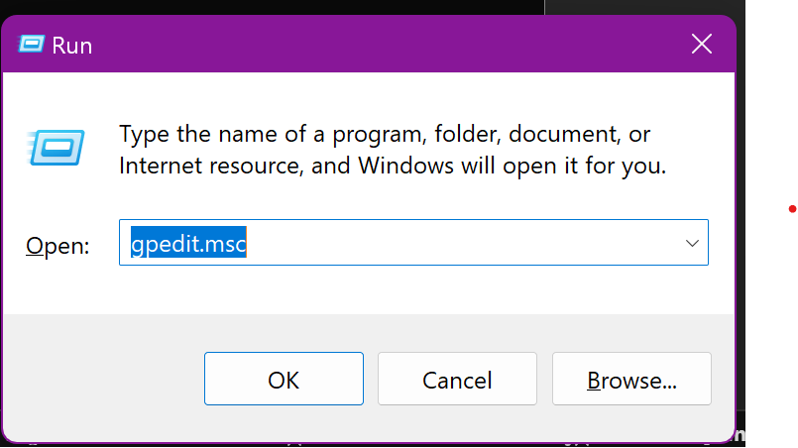
Findings:
1st I went to Windows + Run and typed in gpedit.msc to open the Local Group Policy editor.

Slide 5
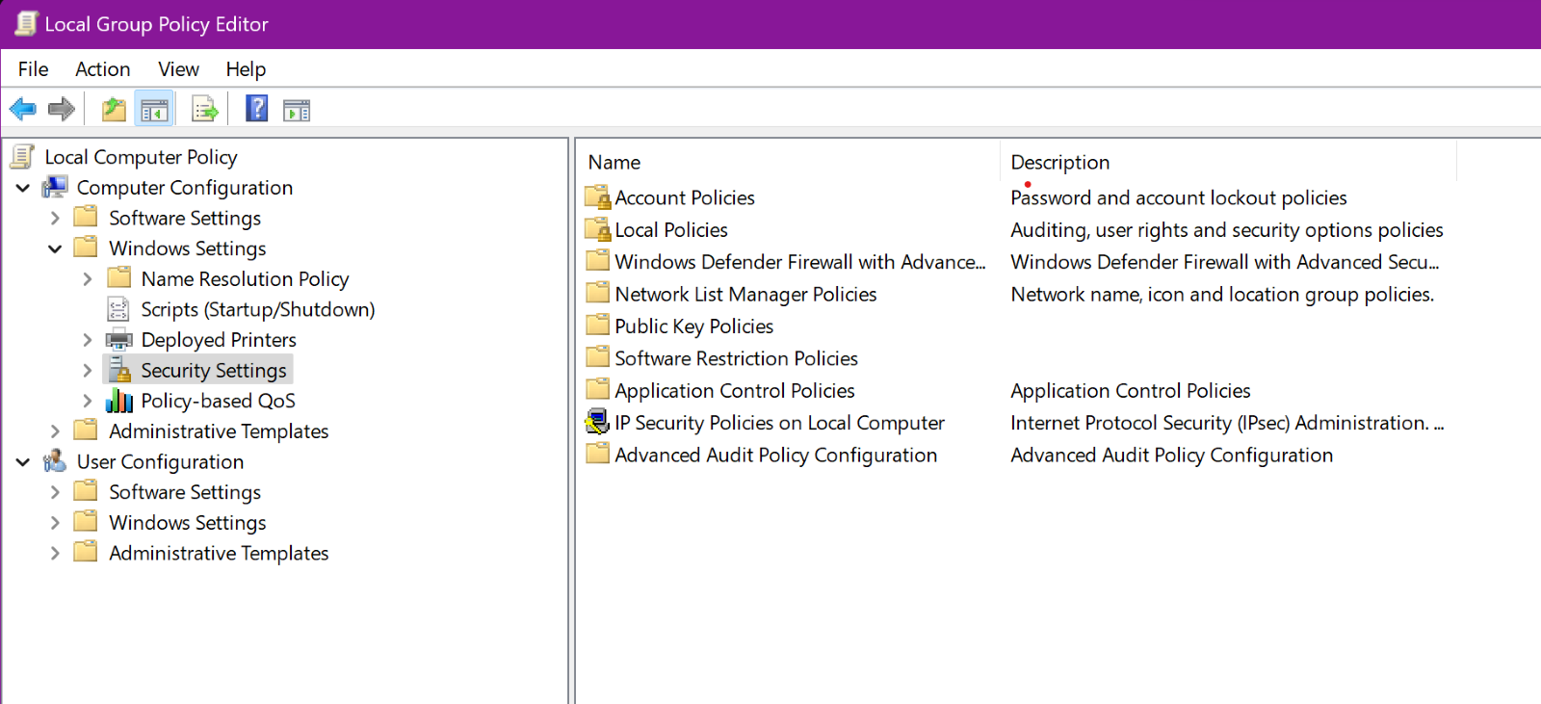
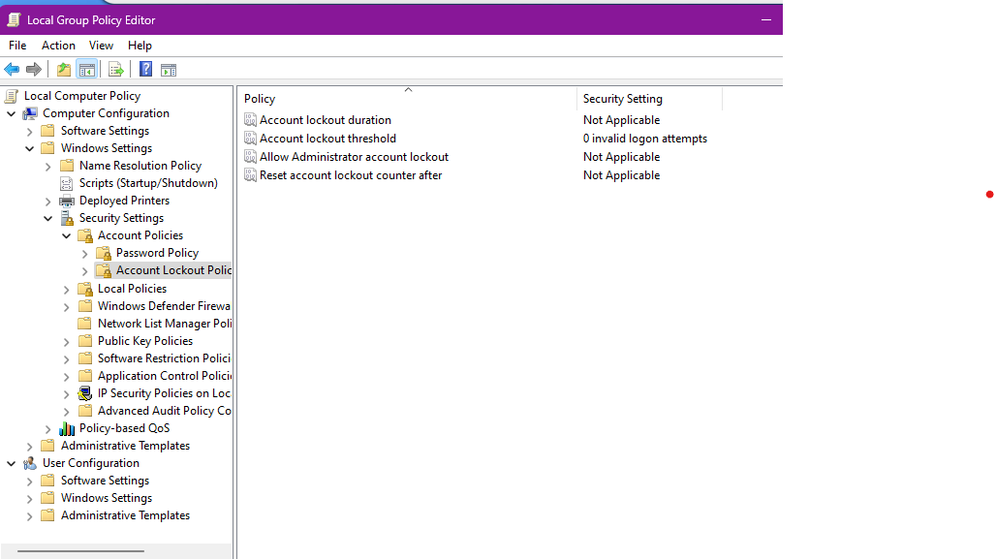
Next Steps:
2nd, I then went to Windows Settings under Computer Configuration, Security Settings, Account Policies, Account Lockout Policy, Account Lockout Threshold

Slide 6
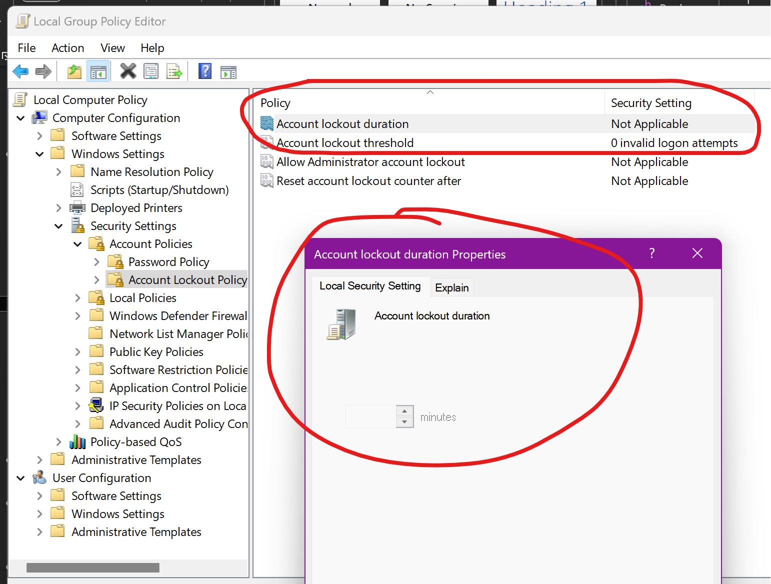
Next Steps:
Is the session timeout set to 15 minutes as per PCI DSS requirements? Based on the session timeout it is set to 0 instead of 15 minutes.
I also noticed that I could not make any changes on the device either.

Slide 7
Compliant Assessment & Recommendation:
This is non-compliant because it does not align with the original policy of the session timeout being set to 15 minutes as per PCI DSS requirements.
Recommendation for Remediation:
Since this is non-compliant, I recommend adjusting the session timeout to 15 minutes to align with PCI DSS.

